Slide 1

Polokwane International Airport

Slide 2


Polokwane International Airport
Pioneering Convenient Air Travel

Slide 3
GAAL LOGO
Pioneering Convenient Air Travel

Slide 4
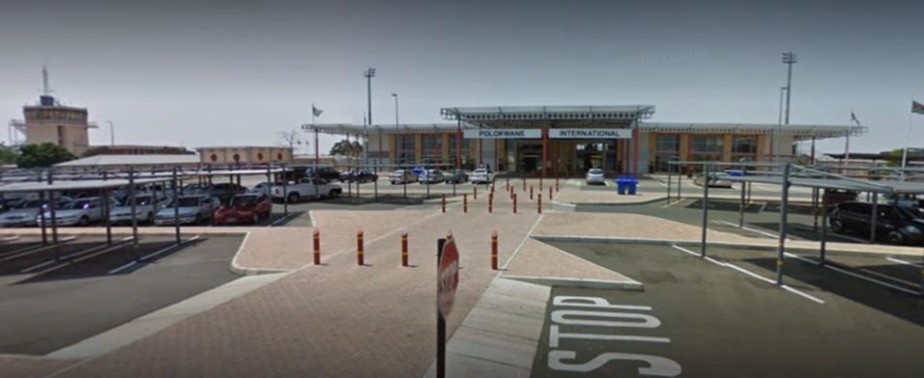

Slide 5


